Slide 1
Speech and Text Emotion Detection using Different Approaches
Course: AI5100
Team members:
Shashank Jerri (AI21MTECH11003)
Aman Ladkat (AI21MTECH14011)
Varshita Sharma(AI21MTECH14009)
Pratik Shetty (AI21MTECH12005)
Maddula Sai Sunamdha Harinhi (AI21MTECH14002)
Instructor:
Dr. Sumohana S. Channappayya
Professor
IIT Hyderabad

Slide 2
Contents
Problem Statement
Motivation
Literature review
Transfer Learning
Methodology
Results
Conclusion
References

Slide 3
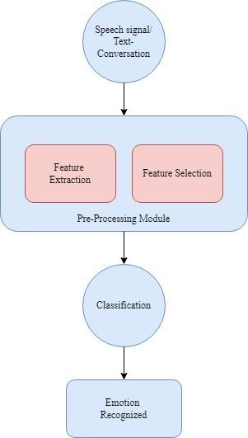
Problem Statement
Detecting and recognizing human emotion is a big challenge in computer vision and artificial intelligence.
The main aim of our project is to develop a robust system which can detect as well as recognize human emotions from provided information.
Information provided is in the form of speech or text.
Notes:
Detecting and recognizing human emotion is a big challenge in computer vision and artificial intelligence be- cause of three main reasons: 1) Human emotion is abstract, which means it is hard to distinguish; 2) In general, human emotion can only be detected in some specific moments during a long utterance; 3) Speech data with emotional labeling is usually limited. This system can also be used to detect and recognize racial differences in emotion recognition. In the automobile industry, in the pursuit to build smart car features, car manufacturers use AI to help them understand human emotions.
It is useful and important for security, healthcare purposes and robotic applications.

Slide 4

Motivation?
Emotion recognition provides benefits to many institutions and aspects of life.
It is useful and important for security, healthcare purposes and robotic applications.
This system can also be used to detect and recognize racial differences in emotion recognition.
In the automobile industry, car manufacturers use AI to help them understand human emotions.

Slide 5
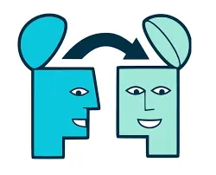
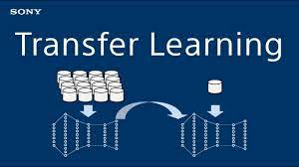
Transfer Learning
Transfer Learning is a machine learning method where we reuse a pre-trained model as the starting point for a model on a new task.
It helps us utilize knowledge from previously learned task and apply it newer (related) ones.

Slide 6

Why Transfer Learning?
Quicker Development
Less Data
Better Results
Notes:
reduced training time,the absence of a large amount of data ,improved neural network performance (in most circumstances),
Pre-trained model has already encoded a lot of information related to text or images. Hence it requires less time and data to get trained. For example in case for fine-tuning bert it requires 2 to 4 epochs in text classification.
Transfer learning has shown to achieve much better performance compared to custom models.

Slide 7
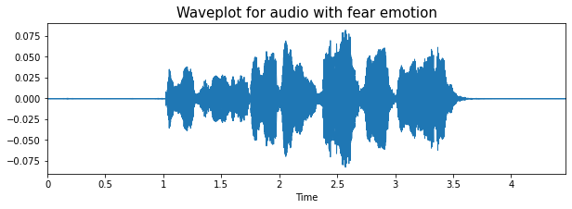
Methodology
Speech Emotion Recognition (using CNN)
Datasets used: TESS, RAVDESS and SAVEE
Step 1: Extracted labels from each dataset separately.
Step 2: Data Visualization
Amplitude envelope of speech signal

Slide 8
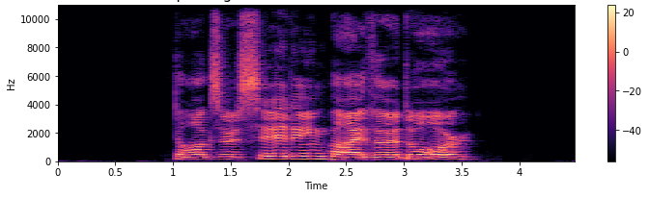
Methodology contd.
Spectrogram of audio file
Step 3: Data Augmentation
Added gaussian noise, pitch shift and signal stretching
Notes:
A spectrogram is a visual representation of the spectrum of frequencies of a signal as it varies with time.
Data augmentation was done to make the model robust and generalize it.
Pitch shifting is a sound recording technique in which the original pitch of a sound is raised or lowered.

Slide 9
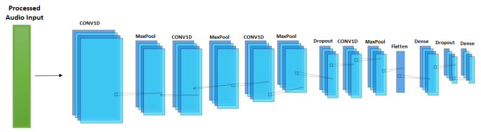
Methodology contd.
Step 4: Feature Extraction
Features extracted:
Zero-crossing rate
Chromagram
Mel Frequency Cepstral Coefficients (MFCC)
Root Mean Square value (RMS)
Step 5: Training
Model used was a CNN with 1D convolution layers
Notes:
The zero-crossing rate (ZCR) is the rate at which a signal transitions from positive to zero to negative or negative to zero to positive.
Chromagram is defined as the whole spectral audio information mapped into one octave. Each octave is divided into 12 bins representing each one semitone.The Chroma filters can be derived from the Chroma filter bank. The filter bank aims to project all the energy of the recorded sound into 12 bins i.e. all the notes we saw, plus the minor/major keys (which is also the black keys of the piano) irrespective of the octave it is in.
mel-frequency cepstrum (MFC) is a representation of the short-term power spectrum of a sound, based on a linear cosine transform of a log power spectrum on a nonlinear mel scale of frequency. Mel-frequency cepstral coefficients (MFCCs) are coefficients that collectively make up an MFC.^{[1]} They are derived from a type of cepstral representation of the audio clip (a nonlinear "spectrum-of-a-spectrum").
The RMS (Root-Mean-Square) value is the effective value of the total waveform.

Slide 10
Methodology contd.
Speech Emotion Recognition (using Transfer Learning)
Datasets used: TESS, RAVDESS AND SAVEE
Step 1: Extracted labels from each of the datasets
Step 2: Feature Extraction
Extracted 3D audio spectrogram
Step 3: Training
Used pre-trained AlexNet model
Notes:
Since Alexnet requires 3D convolution(As spectrogram is a 2D image), we stacked delta spectrogram as the third dimension
This is an example of Transductive Transfer learning where there is similarities between the tasks but the domains are different. Hence it requires more epoch to get trained compared to other transfer learning approaches used in NLP.

Slide 11
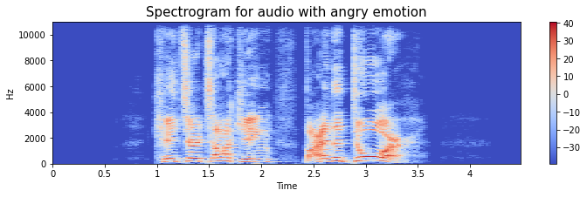


Instance
Feature extraction
Testing
Input audio
ANGRY
Predicted Emotion
One of the extracted features: Spectrogram for input audio

Slide 12
Methodology contd.
Text Emotion Recognition (using LSTM)
Dataset used: IEMOCAP (text)
Step 1 - Data Visualization
Step 2 - Data pre-processing:
Label encoded target classes
Lower casing
Removal of Stop words
Stemming
Tokenization
Notes:
We found that the emotion distribution in the dataset is expectedly non-uniform with the majority emotion being neutral. Hence we decided to choose only 4 emotions for classification ie. anger, happy, neutral, sad.

Slide 13
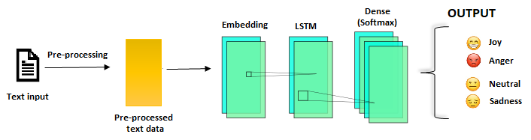
Methodology contd.
Step 3 - Model training:
Used an embedding, an LSTM and a dense layer.
Notes:
LSTM : Able to learn dependencies between sequence of input. Sequence of dialogues in this case.

Slide 14

Instance
Input text
“No we won't. It's pointless it's like a waiting up to see Santa Claus.”
Pre-process
Predication
“pointless like wait see santa clau”
SAD
Predicted emotion
Notes:
Here stemming is done for word ‘reaaly’ to ‘really’.
Stemming is a natural language processing technique that lowers inflection in words to their root forms, hence aiding in the preprocessing of text, words, and documents for text normalization.

Slide 15
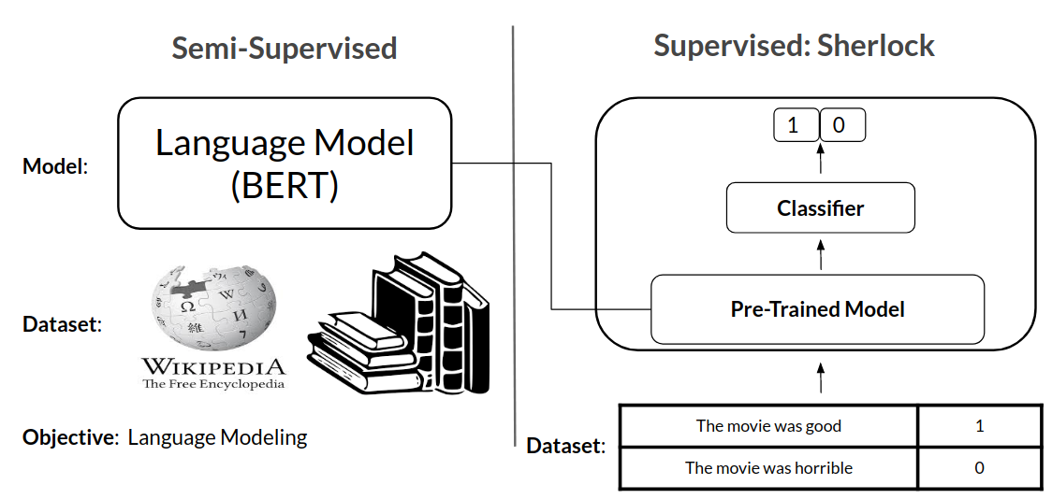
Methodology contd.
Text Emotion Recognition (using Transfer Learning)
Dataset used : IEMOCAP (text)
Pre-trained Model : BERT (bert-based-uncased)
Step 1 - Input Formatting
Add Special Tokens
Fixed Sentence Length and Attention mask
Step 2 - Tokenization using bert tokenizer
Step 3 - Train using BertForSequenceClassification
Step 4 - Use Adam optimiser to update model parameters
Notes:
BERT : Bidirectional Encoder Representations from Transformers, Every output element is connected with every input element and weight between then is calculated using attention score.
Bert-based-uncased : Is a Masked Language Model(MLM) (trained basically like fill-in-the-blanks kind of). Uncased here means the predictions are case insensitive to the input.
Semi-supervised : train on labelled data and predict unlabelled data. Re-train on new data.
Max sentence length = 512
BertForSequenceClassification : This is the normal BERT model with an added single linear layer on top for classification that we will use as a sentence classifier.
One of many other interfaces designed to use pre-trained BERT for specific requirement
Another example : BertForNextSentencePrediction - To predict next sentence
Adam : Every model parameter will have separate learning rate and they will be updated based on both 1st and 2nd moment of gradient descent.

Slide 16
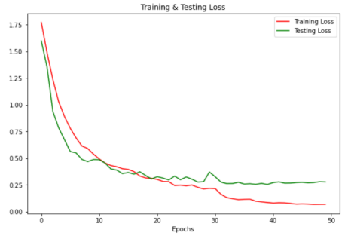
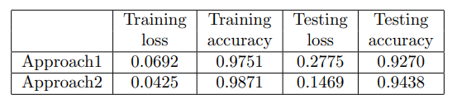
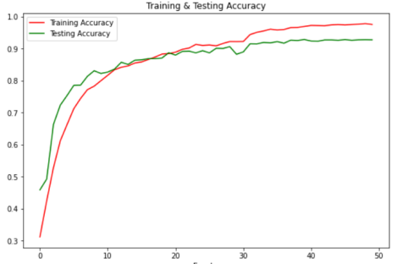
Results
Speech Emotion Recognition
Accuracy and Loss

Slide 17
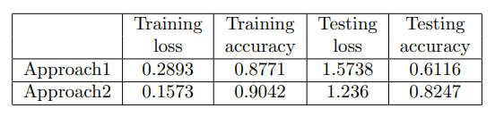
Results
Text Emotion Recognition
Accuracy and Loss

Slide 18
Conclusion
Transfer learning approach for emotion detection and classification performs better than CNN for speech-emotion-recognition and LSTM for text-emotion recognition.
Transfer learning has potential of leveraging multiple sources of emotion-specific speech/text data to improve emotion recognition performance.

Slide 19
References
Z. Peng, Y. Lu, S. Pan, and Y. Liu, "Efficient Speech Emotion Recognition Using Multi-Scale CNN and Attention," ICASSP 2021 - 2021 IEEE International Conference on Acoustics, Speech and Signal Processing (ICASSP), 2021, pp. 3020-3024, doi: 10.1109/ICASSP39728.2021.9414286.
Zhang, Yuanyuan & Du, Jun & Wang, Zirui & Zhang, Jianshu & Yanhui, tu. (2018). Attention Based Fully Convolutional Network for Speech Emotion Recognition. 1771-1775. 10.23919/APSIPA.2018.8659587.
Giannoulis, Panagiotis, and Gerasimos Potamianos. "A hierarchical approach with feature selection for emotion recognition from speech." In LREC, pp. 1203-1206. 2012.
Sharma, J. Jayapradha Soumya, and Yash Dugar. "Detection and recognition of human emotion using a neural network." Int J Appl Eng Res 13, no. 8 (2018): 6472-6477.
Ghosal, Deepanway, Navonil Majumder, Soujanya Poria, Niyati Chhaya, and Alexander Gelbukh. "Dialoguegcn: A graph convolutional neural network for emotion recognition in conversation." arXiv preprint arXiv:1908.11540 (2019).
Guizzo, Eric, Tillman Weyde, and Jack Barnett Leveson. "Multi-time-scale convolution for emotion recognition from speech audio signals." In ICASSP 2020-2020 IEEE International Conference on Acoustics, Speech and Signal Processing (ICASSP), pp. 6489-6493. IEEE, 2020.

Slide 20
Group member contributions
Shashank (AI21MTECH11003) - Speech Emotion Recognition
Pratik (AI21MTECH12005) - Text Emotion Recognition
Aman (AI21MTECH14011) - Speech Emotion Recognition
Varshita (AI21MTECH14009) - Text Emotion Recognition
Maddula Sai Sunamdha Harinhi (AI21MTECH14002) - Text Emotion Recognition

Slide 21
THANK YOU!

